Slide 1

Async
parallel Conference - Session
Rainer Stropek
software architects gmbh
Web
Mail
Twitter
http://www.timecockpit.com
rainer@timecockpit.com
@rstropek
in modern Java/TypeScript

Slide 2
Agenda (German)
JavaScript ist allgegenwärtig. Egal ob Webseite, Progressive Web App, Desktop App (z.B. Electron), Mobile App (z.B. NativeScript), Augmented Reality App (HoloJS) – die Sprache ist überall eine ernstzunehmende Option. Dementsprechend rasant entwickelt sich die Sprache weiter.
In dieser Session geht Rainer Stropek auf aktuelle Entwicklungen in Sachen asynchroner Programmierung in JavaScript ein. Konkret stellt er async/await sowie das ReactiveX Framework (RxJS) für JavaScript vor. Nach einer kurzen, allgemeinen Einführung lernt man beide Technologien anhand von Praxisbeispielen in JavaScript und TypeScript kennen. Unter anderem werden die Anwendung von RxJS und async/await im MEAN-Stack (mongoDB, express, Angular, Node.js) gezeigt.

Slide 3
Promises
Async the ES2015 way

Slide 4
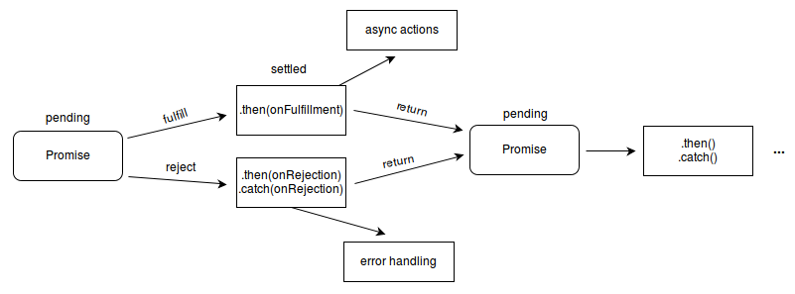
Promise
Promise object used for asynchronous operations
A Promise represents a value which may be available now, or in the future, or never
Part of the ES2015 spec
Polyfills (e.g. es6-promise) for older browsers (see also Promises on Can I use)
Source: Mozilla Developer Network

Slide 5
Promises
Creating promises
Using promises
Error handling
Async/await
See GitHub for source code

Slide 6
async/await
async/await in…
…ES5
…ES2015
…ES2017
See GitHub for source code

Slide 7
MongoDB Example
import * as mongodb from 'mongodb';
import * as chalk from 'chalk';
import * as contracts from './contracts';
async function setupNewDatabase(mongoUrl: string,
initialAdmin: contracts.IInitialAdmin) {
let db = await mongodb.MongoClient.connect(mongoUrl);
let participants = db.collection("participants");
let admin = await participants
.find({ isAdmin: true })
.limit(1)
.toArray();
if (!admin.length) {
// No admin in DB -> create initial admin
await participants.insertOne({
givenName: initialAdmin.givenName,
familyName: initialAdmin.familyName,
email: initialAdmin.email,
googleSubject: initialAdmin.googleSubject,
roles: {
isAdmin: true
}
});
console.log("No admin existed, created one.");
} else {
console.log(chalk.red("DB already configured"))
throw "DB already configured";
}
}
export default setupNewDatabase;
See also MongoClient in Node.js driver for MongoDB
Optional callback
No callback → Promise is returned
See GitHub for source code

Slide 8
Observables
RxJS

Slide 9
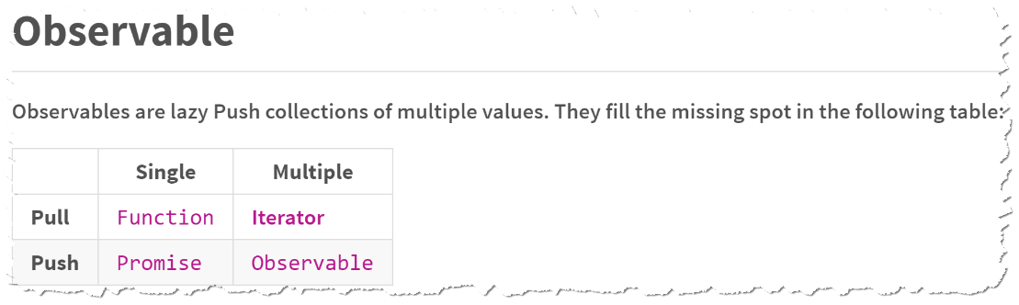
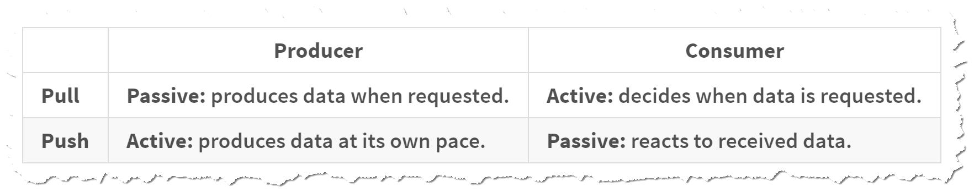
ReactiveX (RxJS)
Observer pattern
Image source: RxJS documentation

Slide 10
Observables
Creating
Rx.Observable.create
Creation operators
Subscribing
Observable.subscribe
Executing
Observer.next, Observer.error, Observer.complete
Disposing
Subscription.unsubscribe

Slide 11
Operators
Compose async code in a declarative manner
Methods on Observable
List of operators see RxJS documentation
Easy switch between RxJS and Promises
Observable.toPromise
Observable.fromPromise
See also http://reactivex.io/rxjs/manual/overview.html#categories-of-operators

Slide 12
RxJS
Creating
Subscribing
Executing
Disposing
See GitHub for source code

Slide 13
Angular Example
@Injectable()
export class PokeSearchService {
constructor(private http: Http) { }
public search(name: string): Observable<IPokemonReference[]> {
return this.http.get(
`http://localhost:1337/pokesearch?name=${name}`)
.map(res => <IPokemonReference[]>res.json());
}
}
Http.get returning Observable
See GitHub for source code

Slide 14
Angular Example
@Component({
selector: 'app-customer-form',
templateUrl: './observables.html',
providers: [PokeSearchService]
})
export class ObservablesComponent implements OnInit {
// Note that this sample uses Reactive forms
public nameControl = new FormControl();
public pokemons: Observable<IPokemonReference[]>;
constructor(private search: PokeSearchService) {}
ngOnInit() {
// Note how we use Rx to debounce values
this.pokemons = this.nameControl.valueChanges
.debounceTime(400)
.distinctUntilChanged()
.switchMap(v => this.search.search(this.nameControl.value));
}
}
Reactive Forms combined with RxJS
See GitHub for source code

Slide 15
Summary
Async shines with Promises, async/await, and RxJS
Works with ES5 and more recent versions
Use Polyfills for Promises in ES5
Use TypeScript to compile async/await to ES5 and ES6
Why RxJS when there are Promises and async/await in ES?
Powerful operators (e.g. retry, cancel)

Slide 16
Q&A
Workshop
Rainer Stropek
software architects gmbh
Mail Web Twitter
rainer@timecockpit.com http://www.timecockpit.com @rstropek
Thank your for coming!

